Slide 1


Transforming Procurement by Putting Supplier at the Core
Procurement Co-Pilot
By
Team All e Technologies
(Rajiv Tyagi, MSN Raju, Rishabh Shukla, Anindo Gupta and Rohan Garg)
Notes:
Hello, this is Team All e Technologies.
We have identified Procurement as an area we want to transform using AI.

Slide 2

Problem Statement
Solution
Activities done as part of Hackathon
Solution Impact & Value Proposition
Necessities to continue

Slide 3

Problem Statement
Unlike Large companies, SMEs do not have high-performing category managers who spend much of their time finding ways to propel value for the business through negotiations and supplier-sourced innovation.
Performing Risk assessment of the Vendors and ensuring that Purchase Orders conform to laid down SOP’s is a time taking and resource intensive exercise. Mostly due to paucity of time and lack of resources, it gets compromised and quick decision are taken.
Notes:
Unlike Large organizations where there are multiple category managers who focus on vendor selection and procurement process, SMEs operate with very lean and thin team structure and lack wherewith drawl of doing structural risk assessment.
Lack of risk assessment at point of origin can lead to subsequent supply chain disruptions

Slide 4


Solution : Procurement CoPilot
Supplier Associated Risk
Operational: Contract, Location, Warranty, Terms
Financial: Price escalation, Currency
Risk Insights
CoPilot performing Risk assessment based on vendor Agreements and Proposals with preconfigured prompts
Reputational: Defaulter, Negative sentiment
Geopolitical: War Zone, Sanctions,
Market Intelligence
CoPilot using public information to highlight Reputational and Geo-Political issues based on user defined prompts
Transaction Associated Risks
Anomalies
CoPilot detecting Anomalies using purchase history available in Business with Preconfigured Prompts
Anomalies: Price, Discount, Payment Terms, Quantity, Lead time strategic
Notes:
We have conceived Procurement CoPilot to empower user to find out Supplier related risk.
When a new Vendor is shortlisted and sent for Approval, Approver can click on Risk Insights and copilot would read between the lines to highlights any operational risks.
Approver can also define prompts to gather market intelligence regarding Geopolitical risks by clicking on Market Intelligence.
Approver can click on ‘Anomalies’ to view if copilot had found any anomalies.

Slide 5
Activities done as part of Hackathon
Team identified two key level use cases
Supplier Risk assessment
Anomalies at PO level
Technical team members enabled the environment by applying for azure open AI subscription to get secret key.
Created a deployment in azure open AI for GPT3.5 turbo for using chat completion.
Created Copilots in BC Sandbox using prompt dialogue page. Used Meta prompt to pass system prompt as secret text.
Code deployment, testing and improvisation of prompts to get better results.

Slide 6

Solution Walkthrough

Slide 7
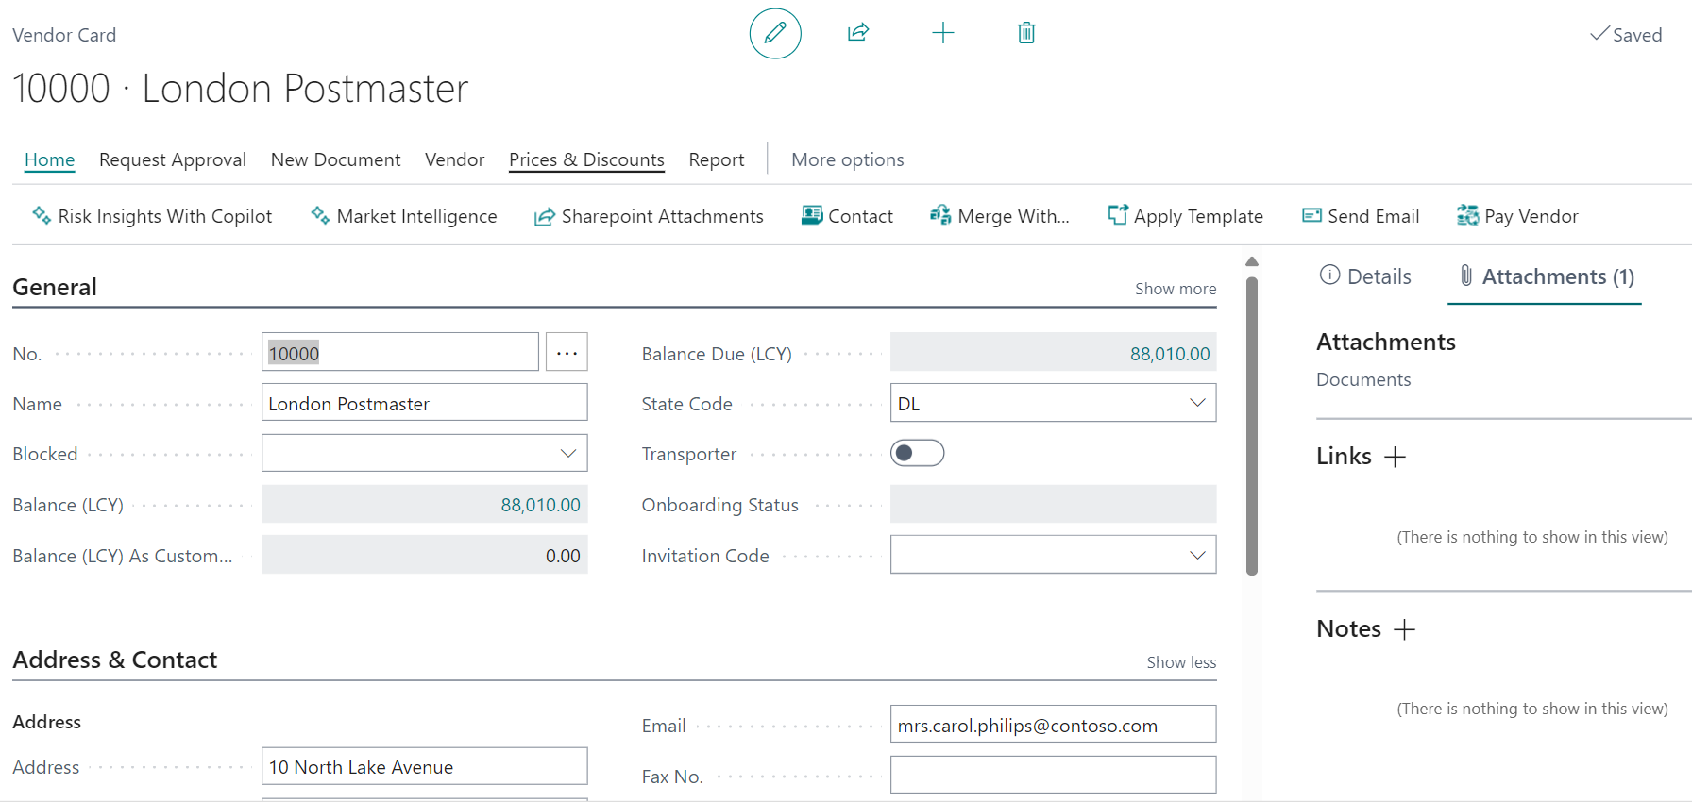
Supplier Associated Risk
Two Prompt interfaces provided on Vendor Master
Risk Insights (Preconfigured)
Market Intelligence (User Definable)

Slide 8
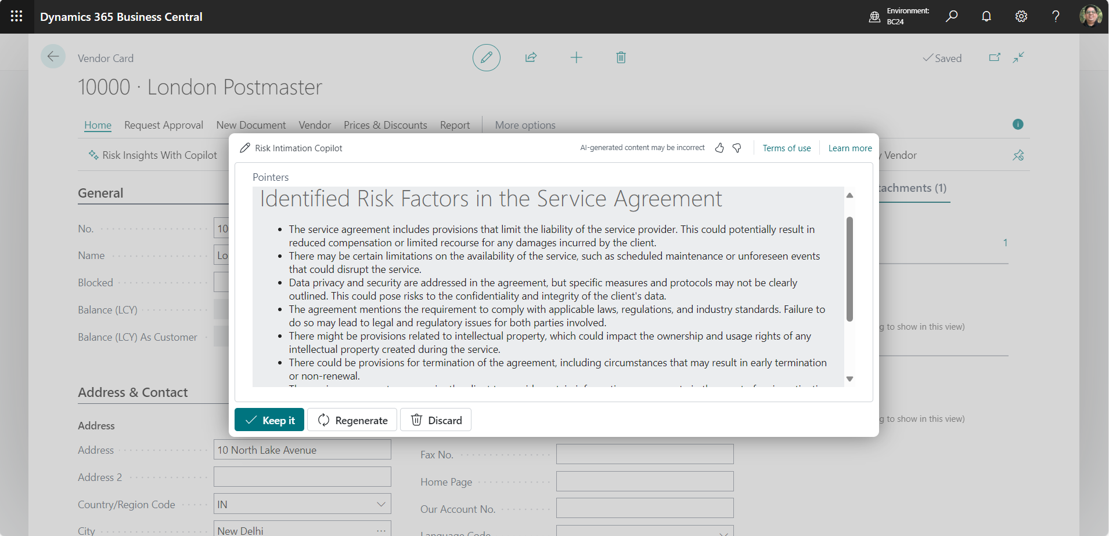
Supplier Associated Risk
Risk Insights
CoPilot performing Risk assessment based on vendor Agreements and Proposals. Preconfigured Prompts highlights risks associated to Price escalation, Terms and conditions, IP rights, warranty, Performance Guarantee, legal jurisdiction etc .

Slide 9
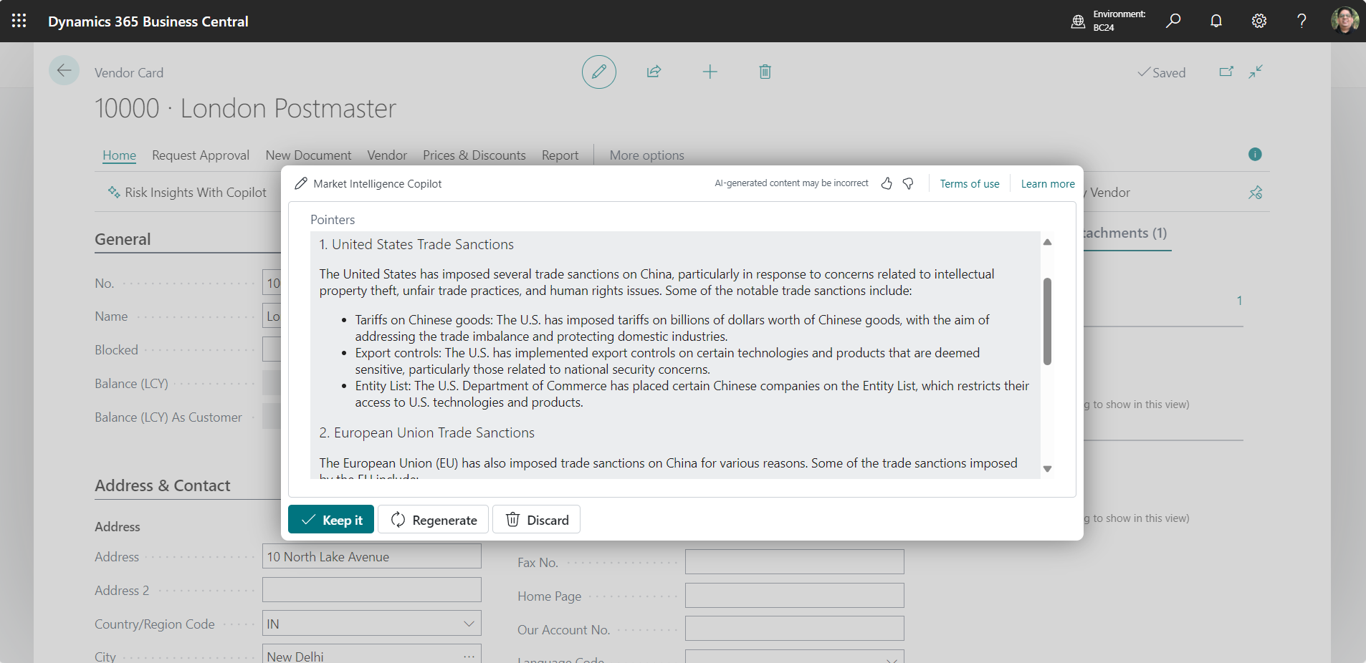
Supplier Associated Risk
Market Intelligence
CoPilot using public information to highlight Reputational and Geo-Political issues by using User Defined Prompts.
User has used prompt ‘Any Trade Sanctions imposed on China’

Slide 10
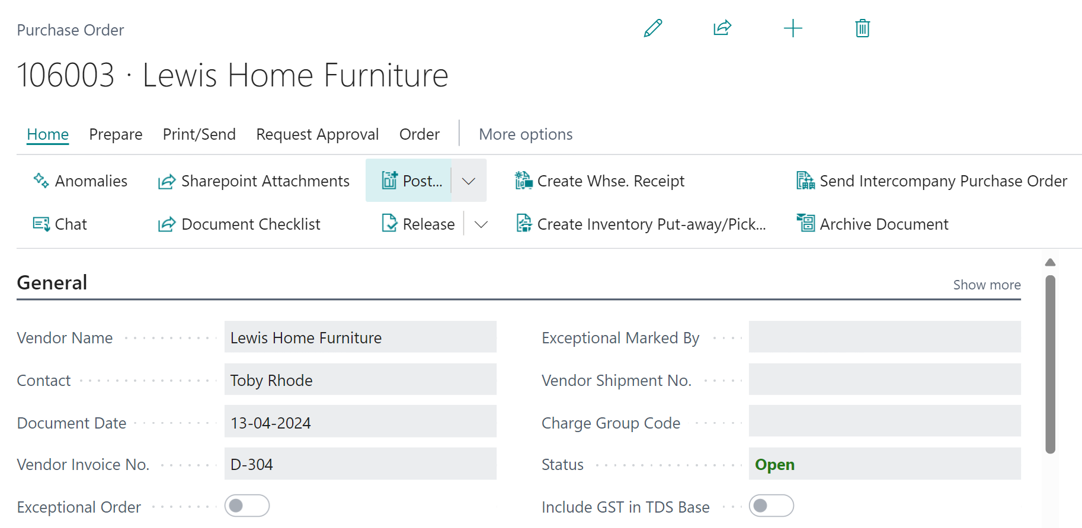
Transaction Associated Risks
Anomalies
Pre configured Prompt interfaces called ‘Anomalies’ is provided on Purchase Order page, so that Approver can scrutinize any errors and omissions

Slide 11
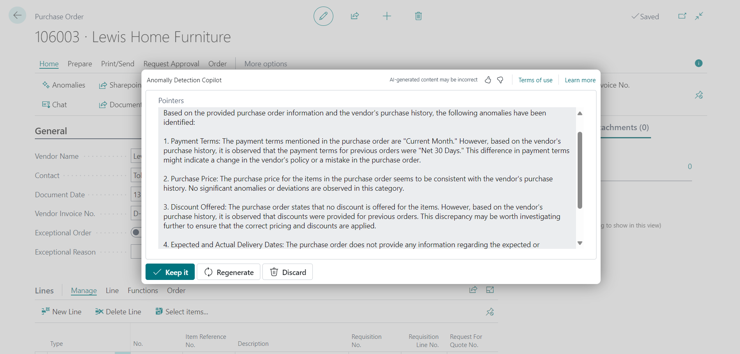

Slide 12
Solution Impact and Value Proposition
Empowers Users to mitigate business risk at lightning speed and minimal cost
Time & Cost Efficient
Easy to Use
Scalable and open to Innovation
Overall Process Improvement as anomalies get detected at the point of origin

Slide 13
Necessities to Continue
Need to work om Prompt Engineering to improve the output by training it on diverse range of documents.
Expand the BC data source by including more tables to include Vendor performance analysis
CoPilot for Requestors to help them make requests, converse regarding purchase policies

Slide 14
Thank You

